Slide 1
Classification, Clustering, and Evaluation
By: Satyen S.

Slide 2
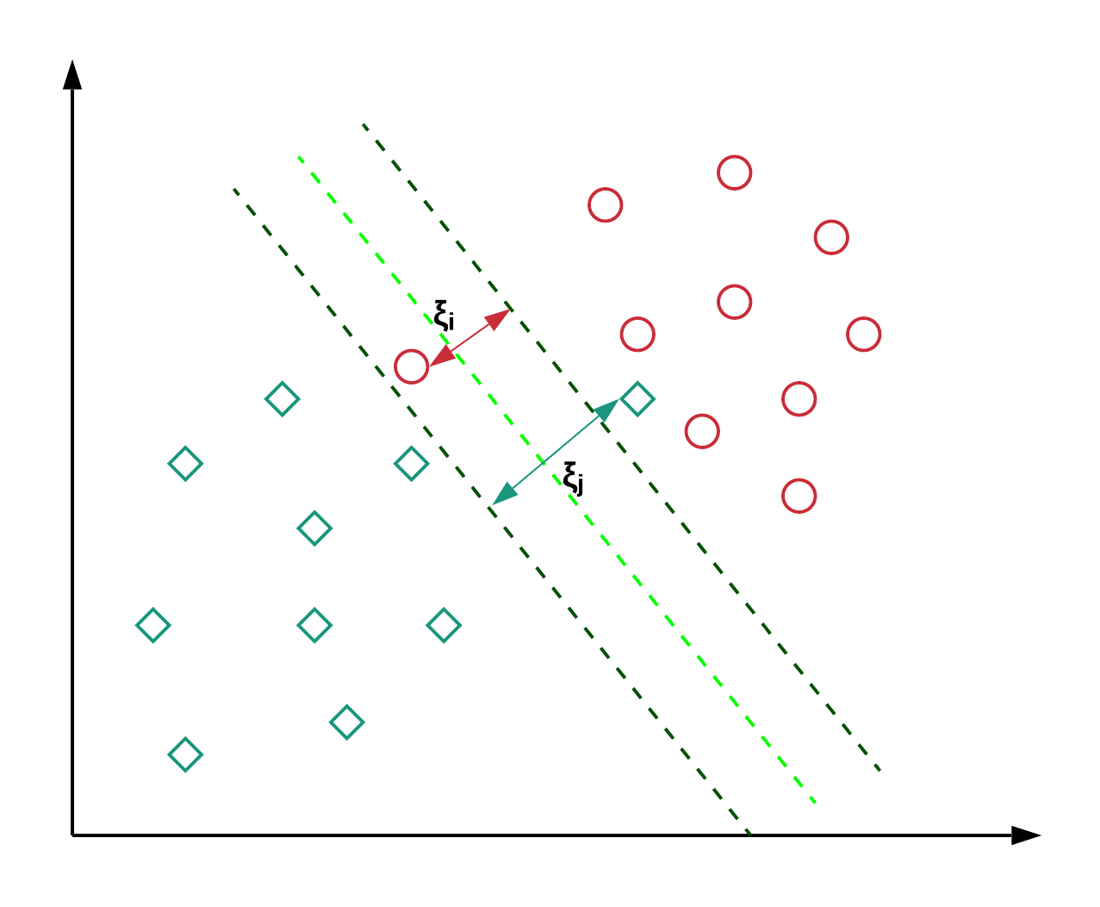
Recap: Regression Concepts
Which type of model is characterized by a optimizing a hyperplane (and the error from a margin)?
Polynomial
Random Forest
SVM
Logistic

Slide 3
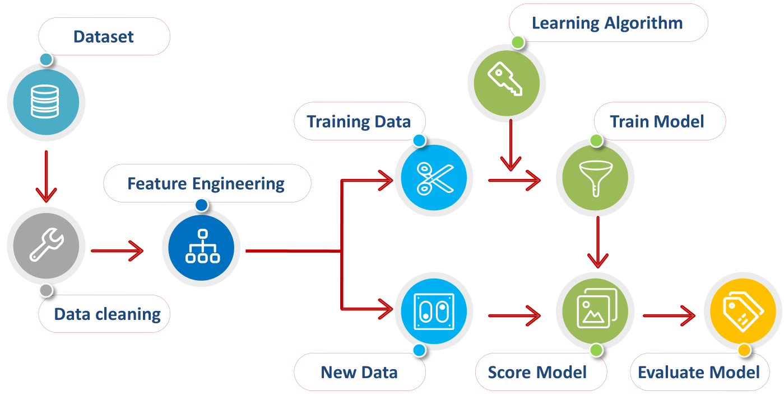
Recap: Preprocessing Data
Which of the following should come LAST?
Scaling
Imputing
Encoding
Dropping Rows

Slide 4
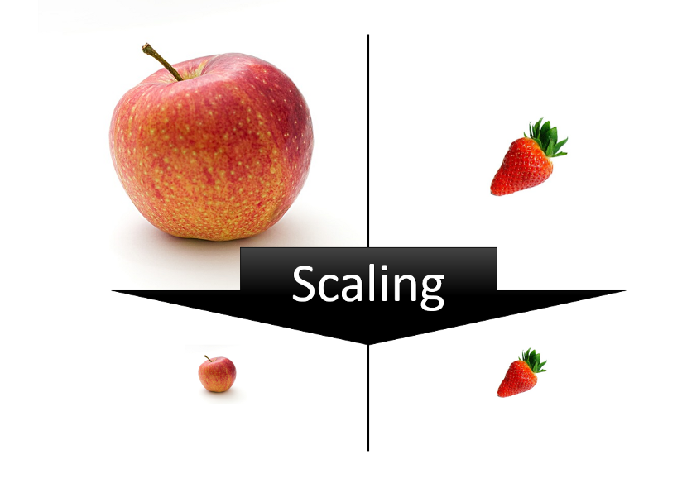
Recap: Preprocessing Data
At which point does it make sense to scale our processed data?
After loading data into notebook
After imputing null values
Just before splitting data into test and train
After splitting data into test and train

Slide 5

Recap: SciKit Learn Models
Which function call correctly trains a SciKit Learn model?
.fit()
.transform()
.train()
.perform()

Slide 6
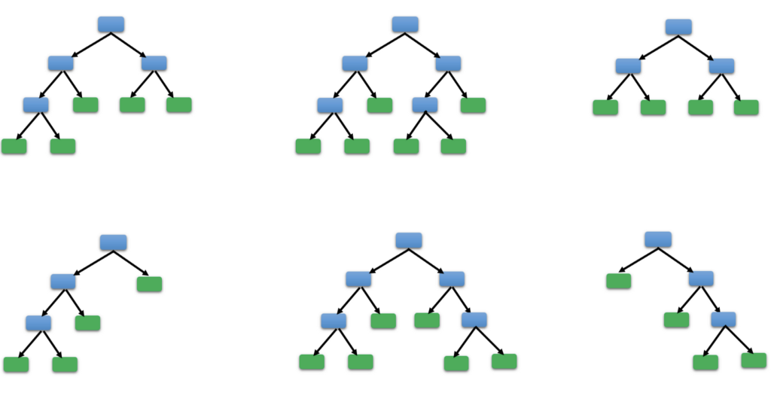
Regression Models: Hyperparameters
Q: Why is understanding concept behind models important?
Hyperparameters: parameters used to control model training process
Ex: RandomForestRegressor
Can specify the depth of the trees
Can specify the number of trees in the forest
Can specify the evaluation metric to minimize
View full list at: https://scikit-learn.org/stable/modules/generated/sklearn.ensemble.RandomForestRegressor.html#sklearn.ensemble.RandomForestRegressor

Slide 7
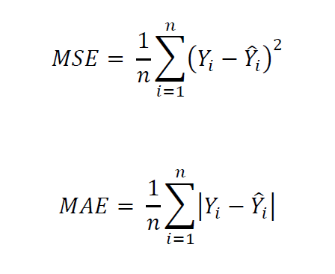
Regression Models: Metrics
Can optimize metric when training
Specify “criterion”
ex: r = RandomForestRegressor()
Can view scores after trained (sklearn.metrics)
max_error(predictions, correct)
mean_absolute_error(predictions, correct)
mean_squared_error(predictions, correct)
Full list: https://scikit-learn.org/stable/modules/classes.html#sklearn-metrics-metrics

Slide 8
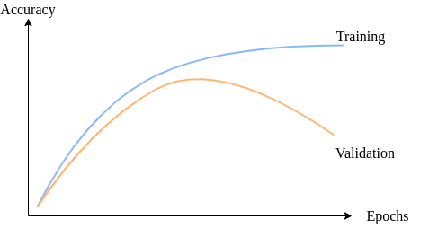
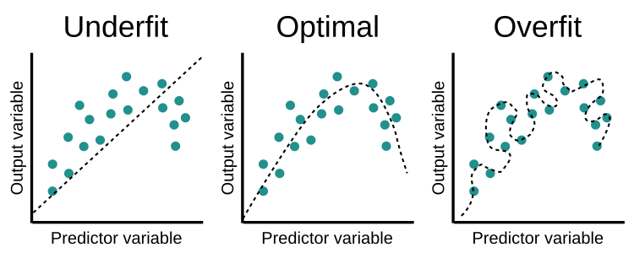
Supervised Learning: Evaluation
Lack of variance or too many repetitions (epochs) -> Overfitting
Save portion of dataset from testing
Keep testing set independent of scalers
Can evaluate with metrics from earlier slide

Slide 9

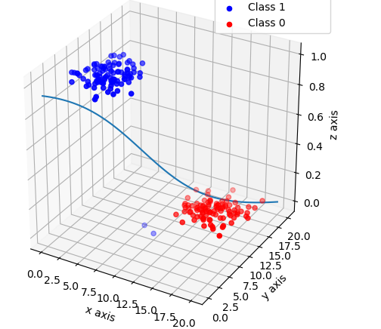
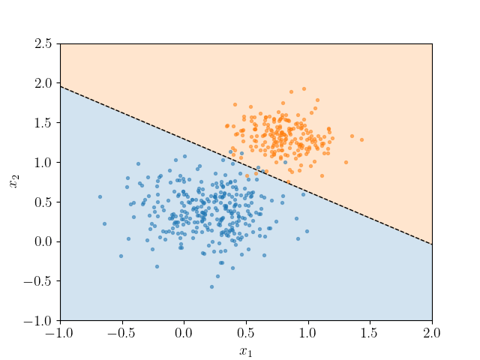
Classification Models: Logistic Regression
Predicts outcome between two classes by creating “decision boundary”
Plugs weighted inputs into activation function (generally sigmoid)
Ex: y = σ(k₁x₁ + k₂x₂ + b)
SciKit Learn: https://scikit-learn.org/stable/modules/generated/sklearn.linear_model.LogisticRegression.html

Slide 10
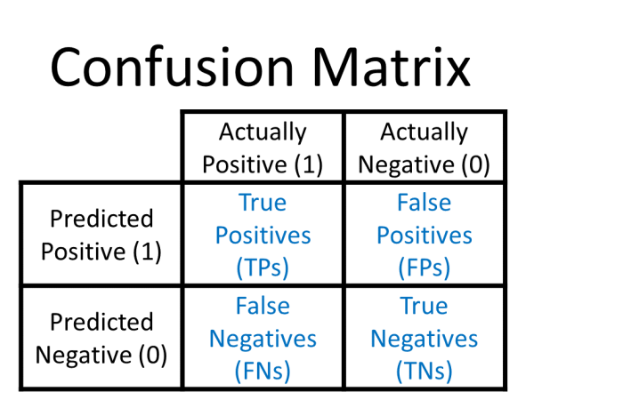

Classification Models: Confusion Matrix (Evaluation)
Q: How do we evaluate our classification models?
Confusion Matrix can help visualize success
Accuracy Score
Full list: https://scikit-learn.org/stable/modules/model_evaluation.html#classification-metrics

Slide 11
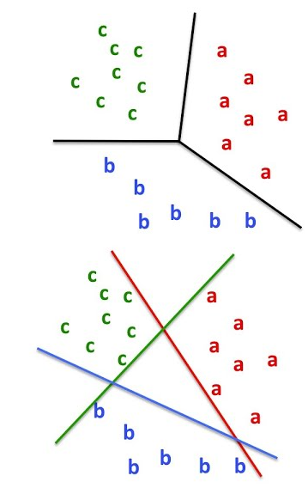
Classification Models: Support Vector Machine
Multiclass classification
One against all
One against one
Similar to SVM Regression, but creating decision boundaries
Constructs hyperplane minimizing error of predicted class
Can use Kernel for non-linear scenarios
API: https://scikit-learn.org/stable/modules/generated/sklearn.svm.SVC.html

Slide 12
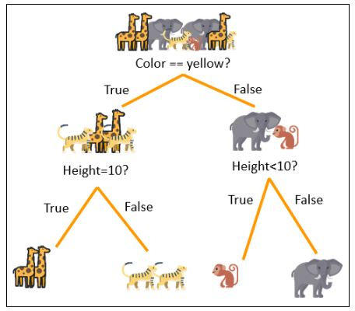
Classification Models: Decision Trees
Similar to Regression Decision Trees
Predicts class instead of value
Lends itself better to model structure
Can combine trees to form a Random Forest Classifier
API: https://scikit-learn.org/stable/modules/generated/sklearn.ensemble.RandomForestClassifier.html

Slide 13
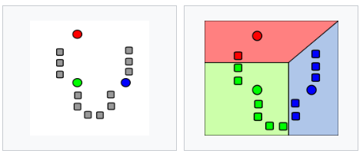
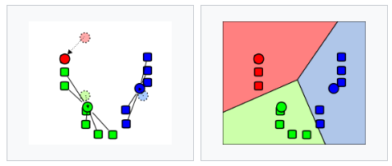
Clustering Models: K-Means
Assign k random centroids
Partition data based off of closest centroid
Move centroid to mean of partitioned data
Throw out partitions, repeat step 2-3
Notes:
Unsupervised practice

Slide 14
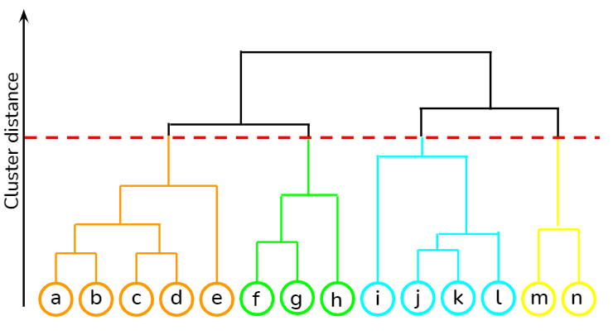
Clustering Models: Hierarchical
Establish every datapoint as an individual cluster
Combine nearest clusters
Repeat until all data falls into a single cluster
Construct a dendrogram ------>
Determine how many target clusters and organize results

Slide 15
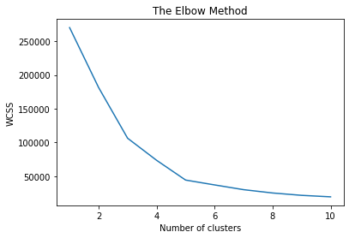
Clustering Models: Evaluation
Elbow Method: Observing the Within Cluster Sum of Squares
Aim for the bottom of the elbow (4-5 clusters on diagram)
In practice: run model multiple times to calculate WCSS score

Slide 16
Demo: SciKit Learn Classification Models
Let’s make some models!
Completed: https://colab.research.google.com/drive/155KxvuyfbkatyWK-TD61gkqQnwFCl-vq?usp=sharing

Slide 17
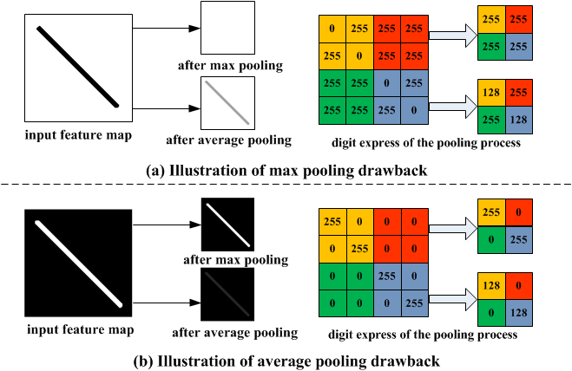
Dimensionality Reduction: Image Pooling
Classification models can take a REALLY long time to train
Ex: Colored Image
256x256 pixels
3 layers of colors
Compromise: Dimensionality Reduction
Max pooling
Average pooling

Slide 18
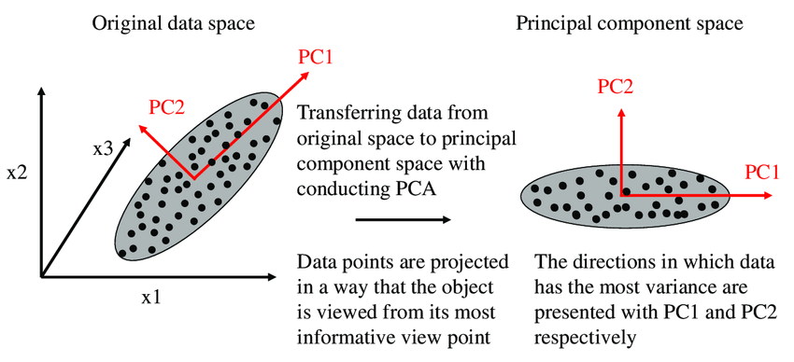
Dimensionality Reduction: Principal Component Analysis (PCA)
Dimensionality reduction through linear algebra
Uses eigenvalues to create most important dimensions from data
Projecting data in N dimensions into K dimensions (K < N)
SciKit Learn: https://scikit-learn.org/stable/modules/generated/sklearn.decomposition.PCA.html
Note: Can be used with a kernel

Slide 19
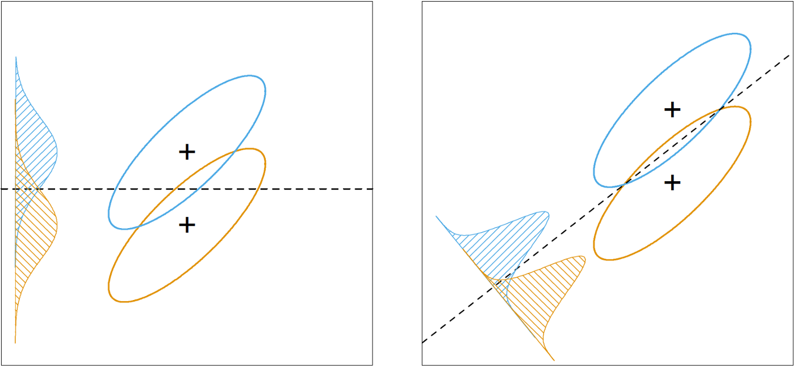
Dimensionality Reduction: Linear Discriminant Analysis (LDA)
Dimensionality reduction through maximizing axis distribution
Can specify the number of target dimensions
Ex: 2D -> 1D
SciKit Learn: https://scikit-learn.org/stable/modules/generated/sklearn.discriminant_analysis.LinearDiscriminantAnalysis.html

Slide 20
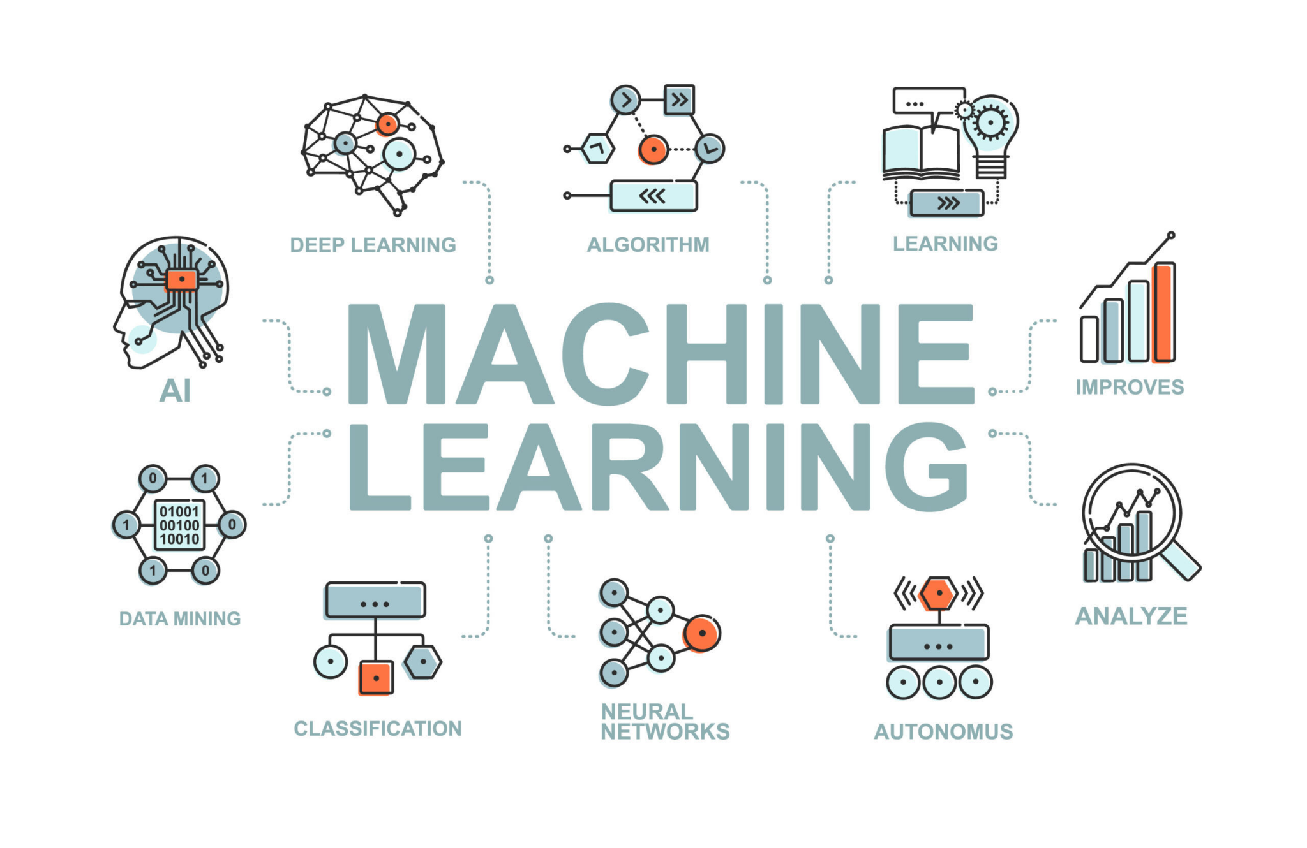
Tips and Resources
SciKit Learn API is your friend for making models
Good idea to work with small dataset, train a weak model, then run the code again with the full dataset
Data Engineering is at LEAST 50% of the Machine Learning Process

Slide 21
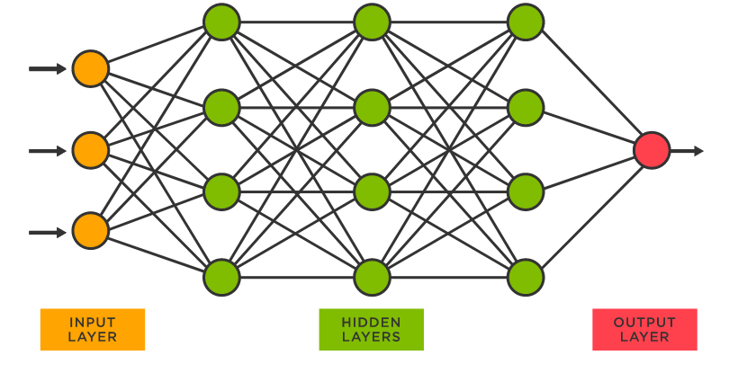
Looking Forward: Neural Networks
Deep Learning: Regression, Classification, Time Series, Reinforcement Learning
Notes:
Neural Networks: for next time

